Slide 1
Airborne Sampling/Sensing
of Distal Volcanic Ash
Project Sponsor:
Defence Technology Agency
Project Supervisor:
Professor Maan Alkaisi
Special thanks to RNZAF, SERC & NIWA

Slide 2
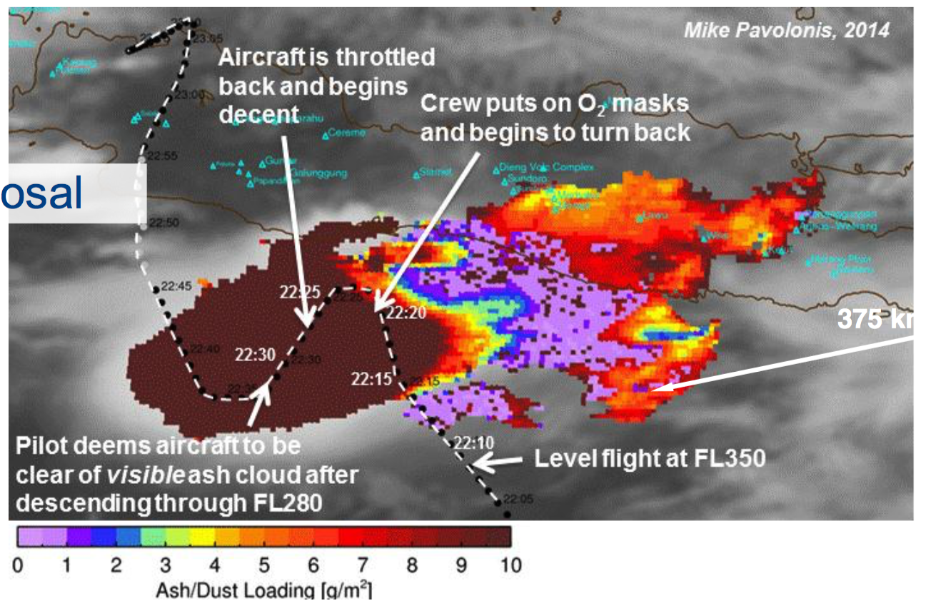
Satellite Images

Slide 3
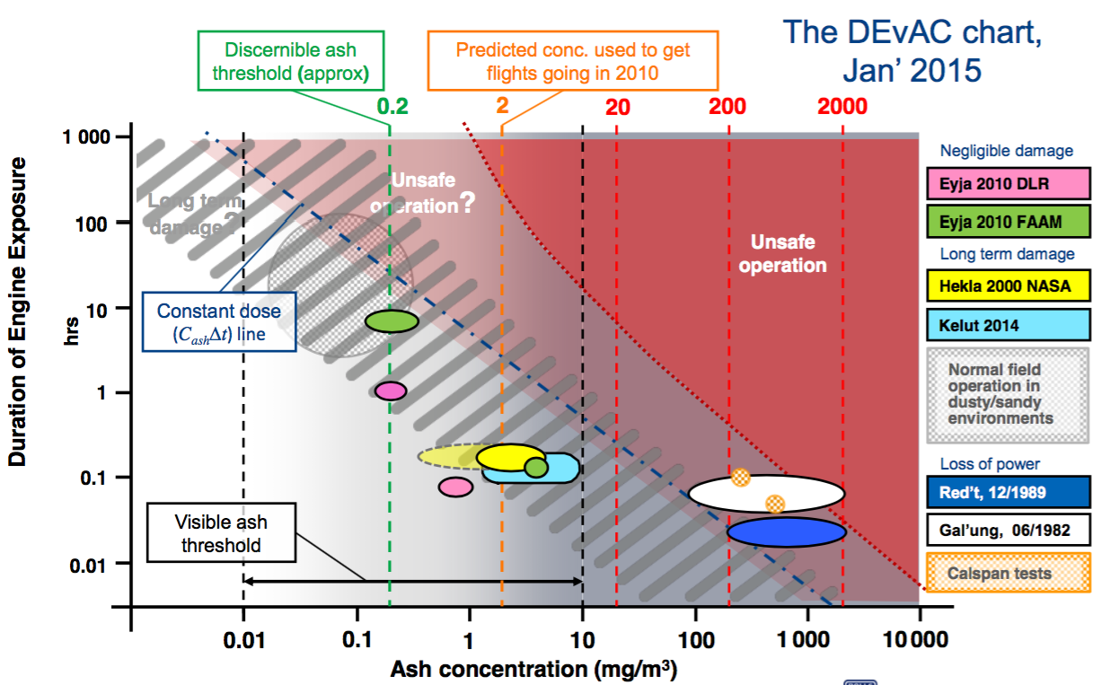
Ash Concentration

Slide 4
Project Requirements
Low cost
Recoverable
Live sensing
Binary detection
Ash concentration
Particle size distribution
Physical sample

Slide 5
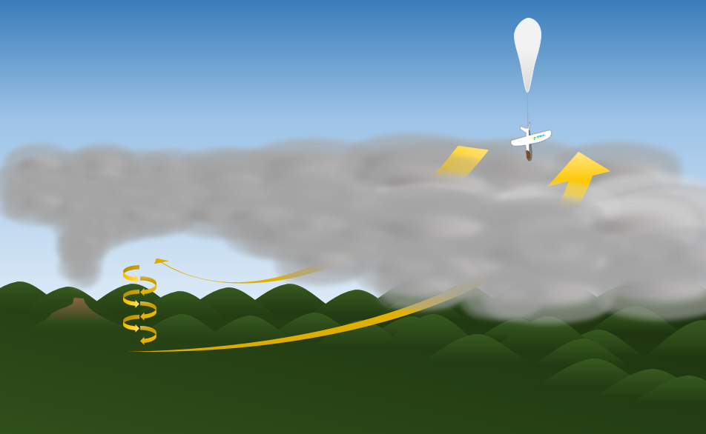
Proposed Solution

Slide 6
Individual tasks
Ryan – Ash sampling
Parth – Electrostatic sensor
Jake – Novel ash sensor, modelling
Jamie – Particle sensor testing
Mike – Flight electronics and telemetry

Slide 7
Volcanic Ash Physical Sampling System
Ryan Taylor

Slide 8
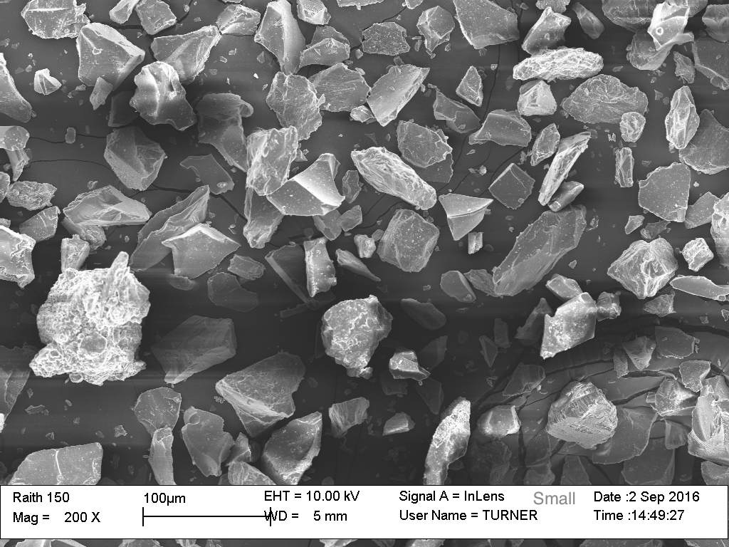
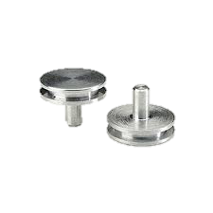
Viewing samples
To analyse a sample it will be viewed under a scanning electron microscope (SEM)
Volcanic ash needs to land on carbon tape
Carbon tape is only adhesive
down to 0 C

Slide 9
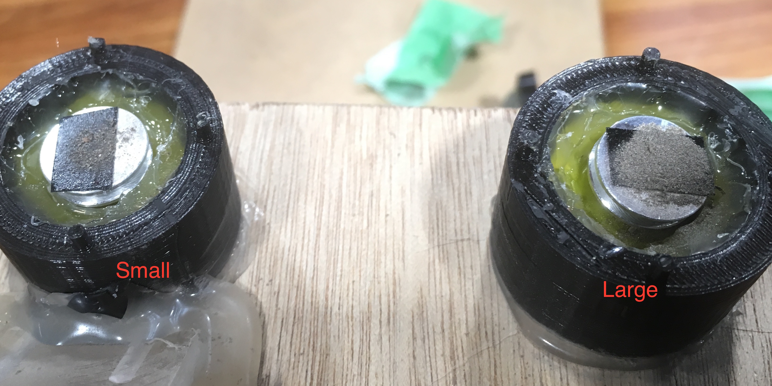
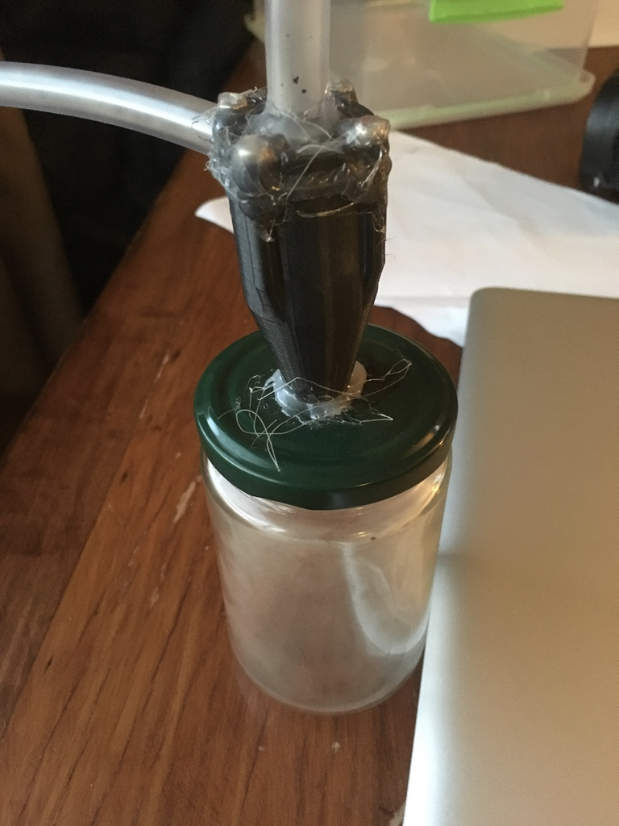
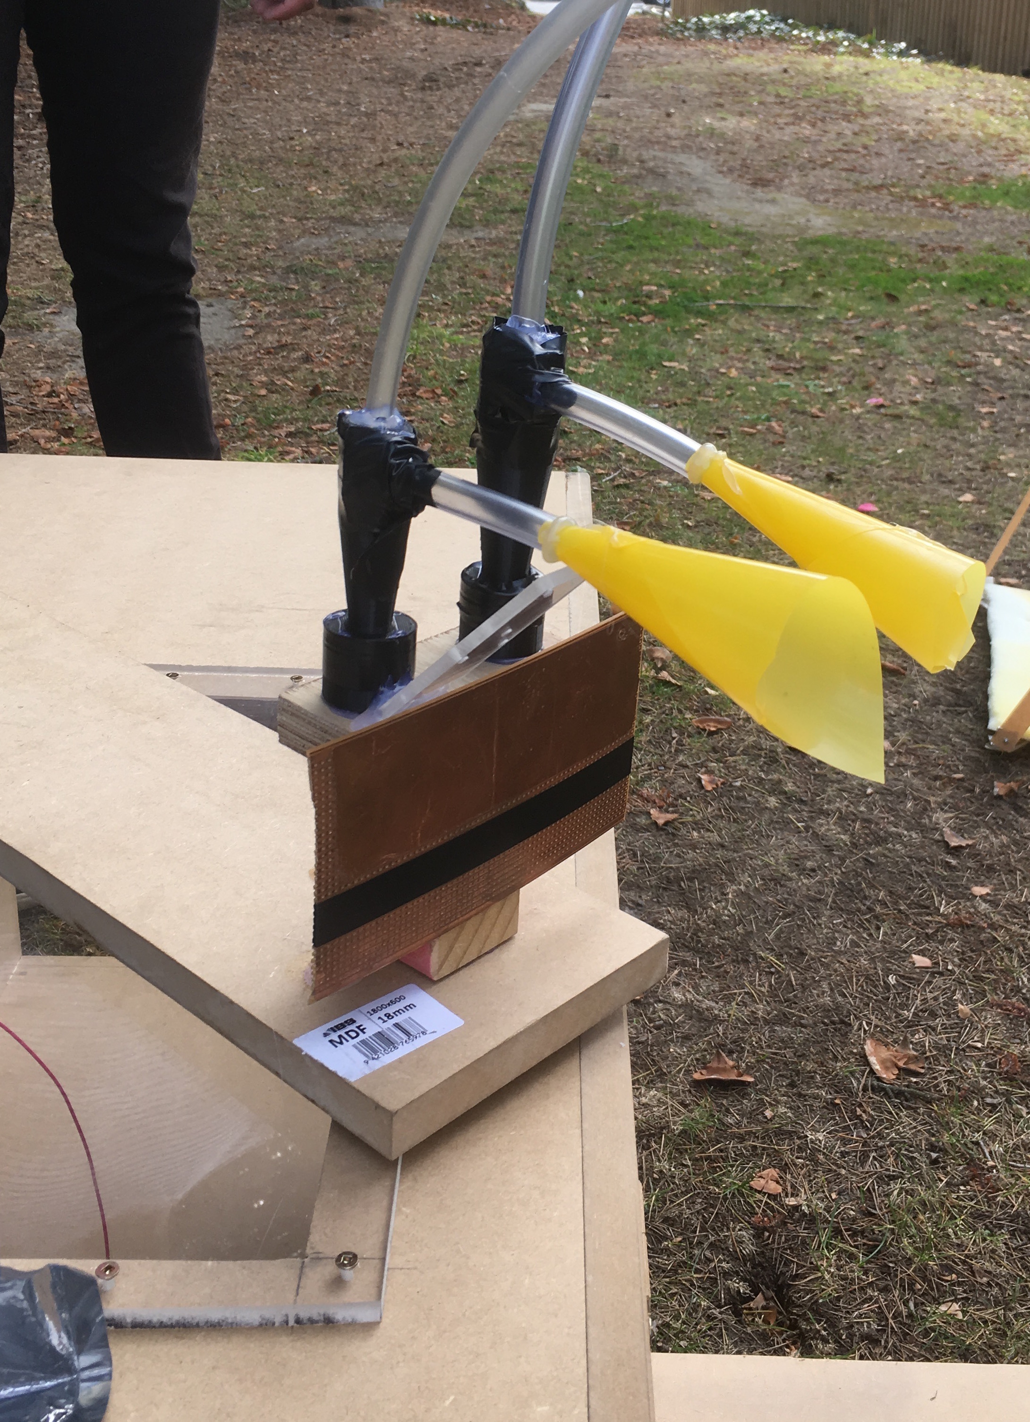
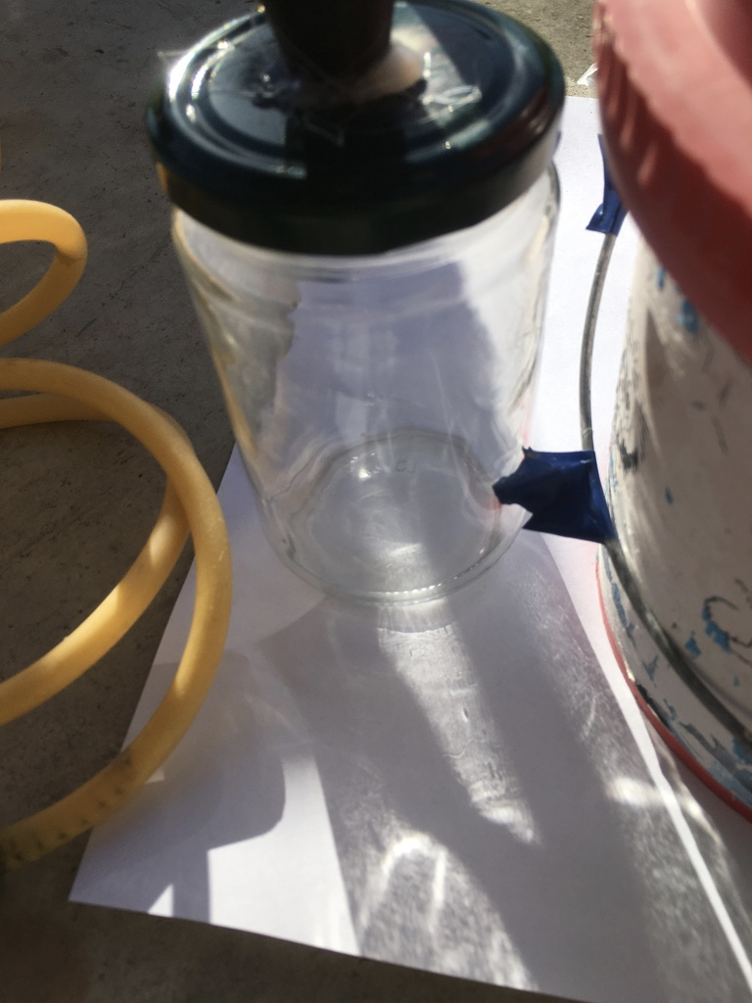
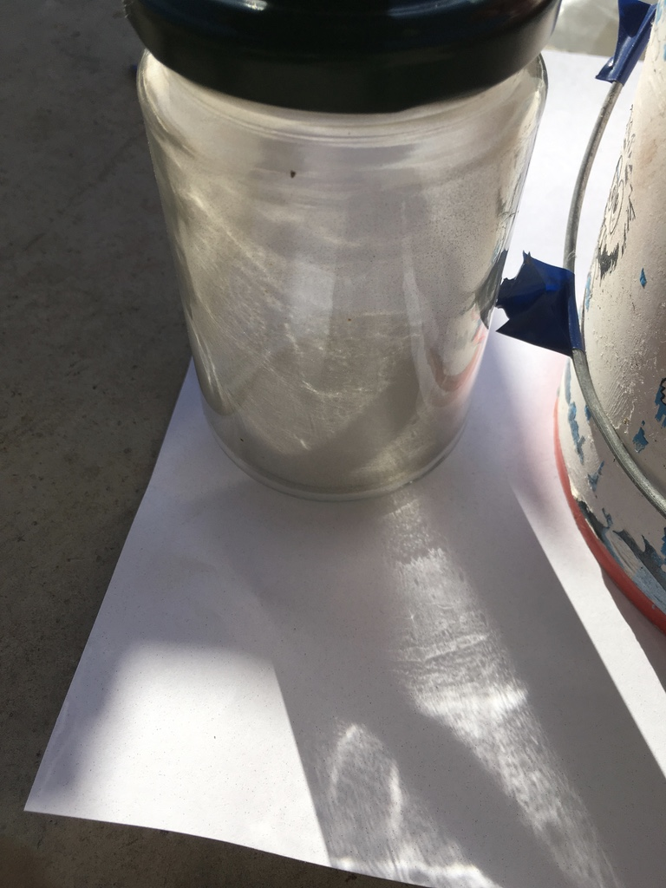
Physical Volcanic Ash Sampler
Frist design
Proof of concept
Second design
Testing cyclone size
Before
After

Slide 10
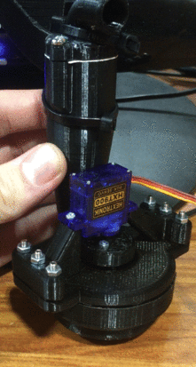
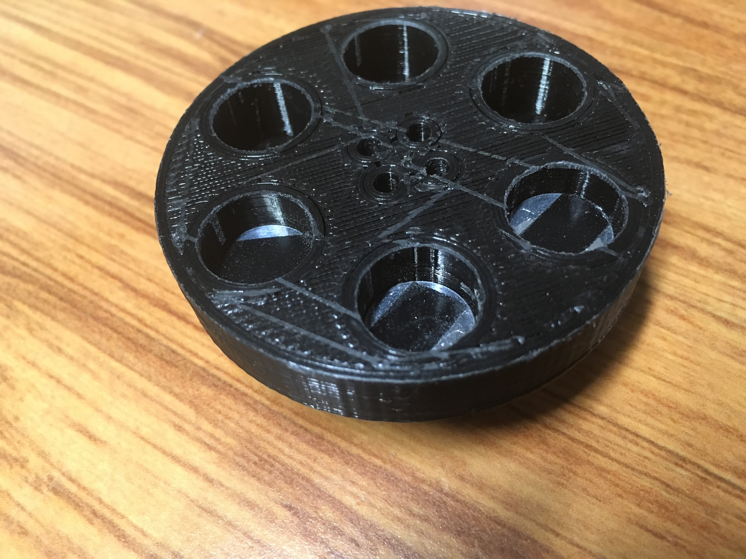
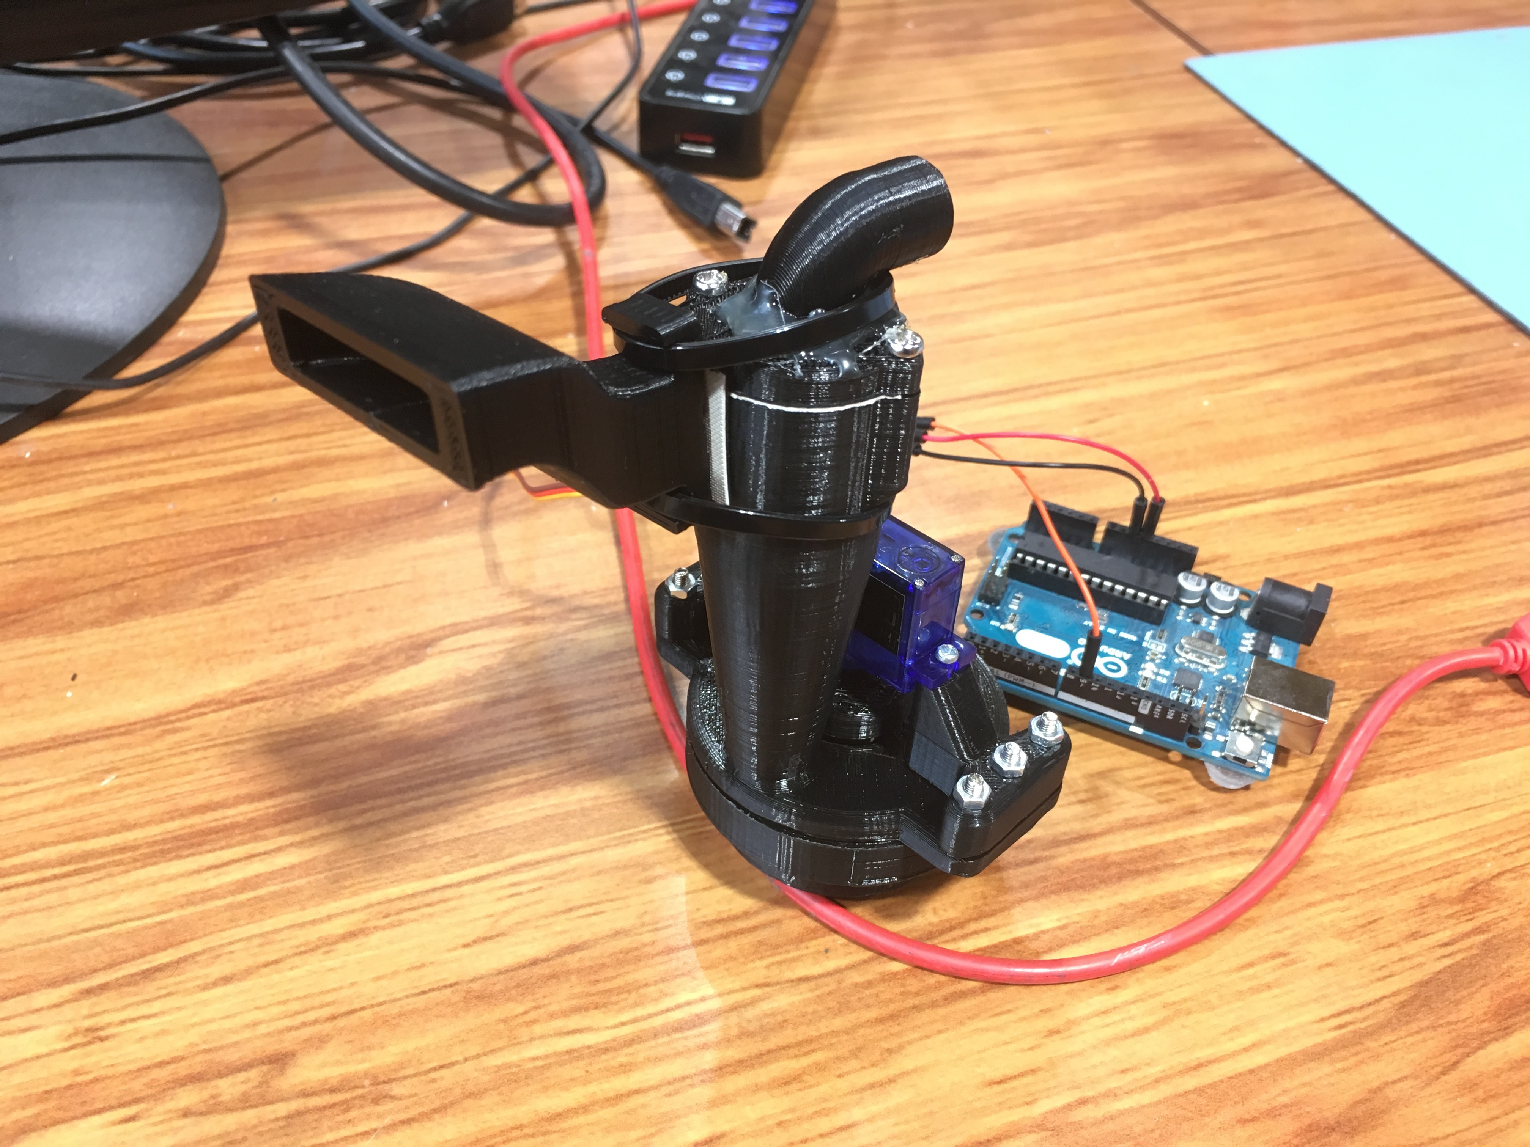
Current Design Rotary base for multiple samples

Slide 11
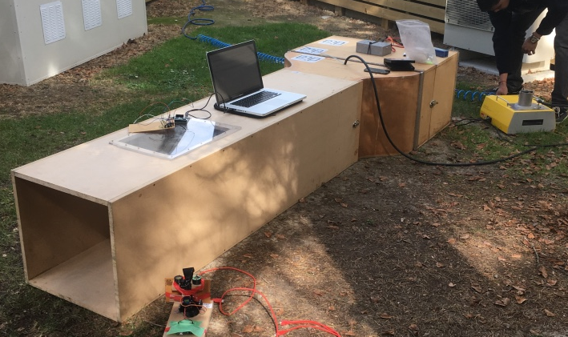
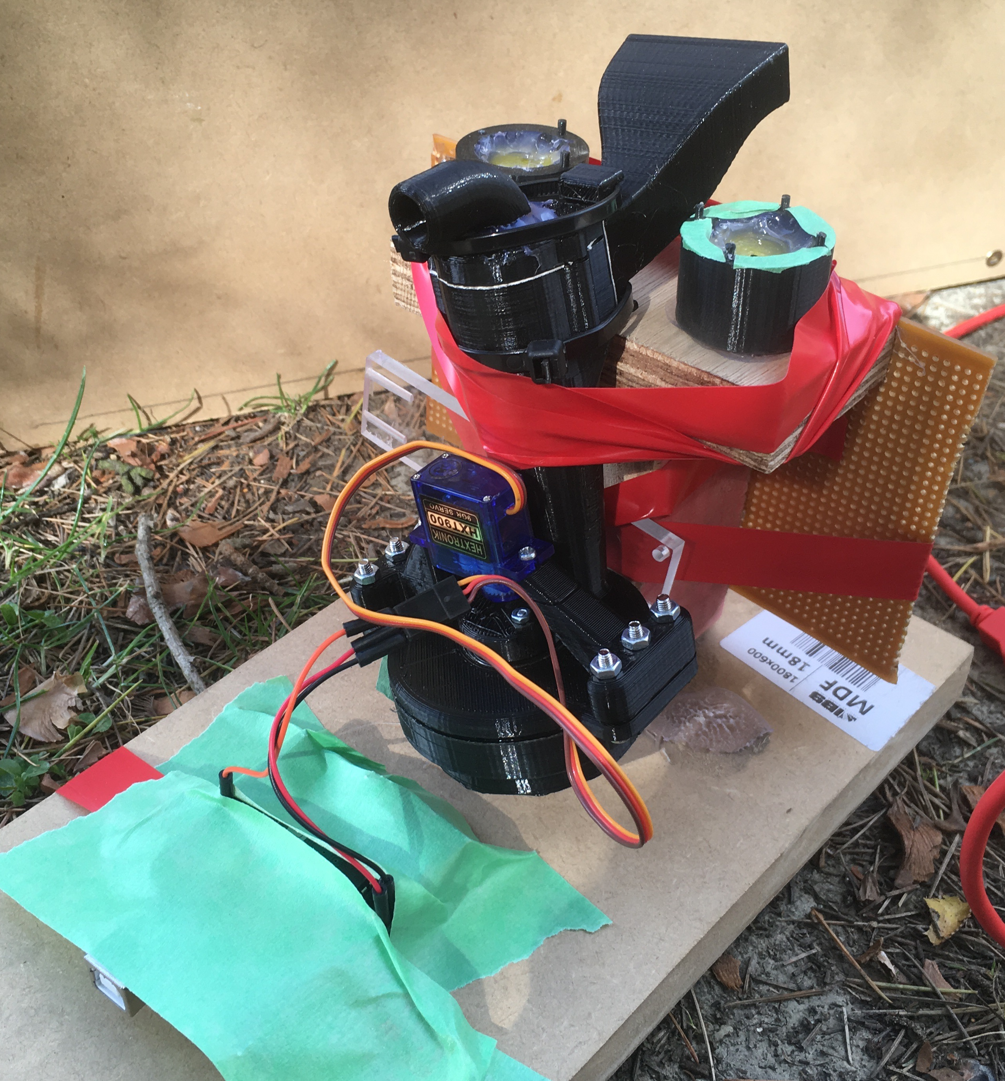
Testing cyclone in wind tunnel
Testing conditions needing to be met
Air speed of 5m/s
Ash concentration 10mg/m^3
Particle size < 50 micron
Temperature 20C to -20C
Air density 1/3 of ground level air density
Solid aerosol generator (SAG)
Rotary cyclone prepared for testing

Slide 12
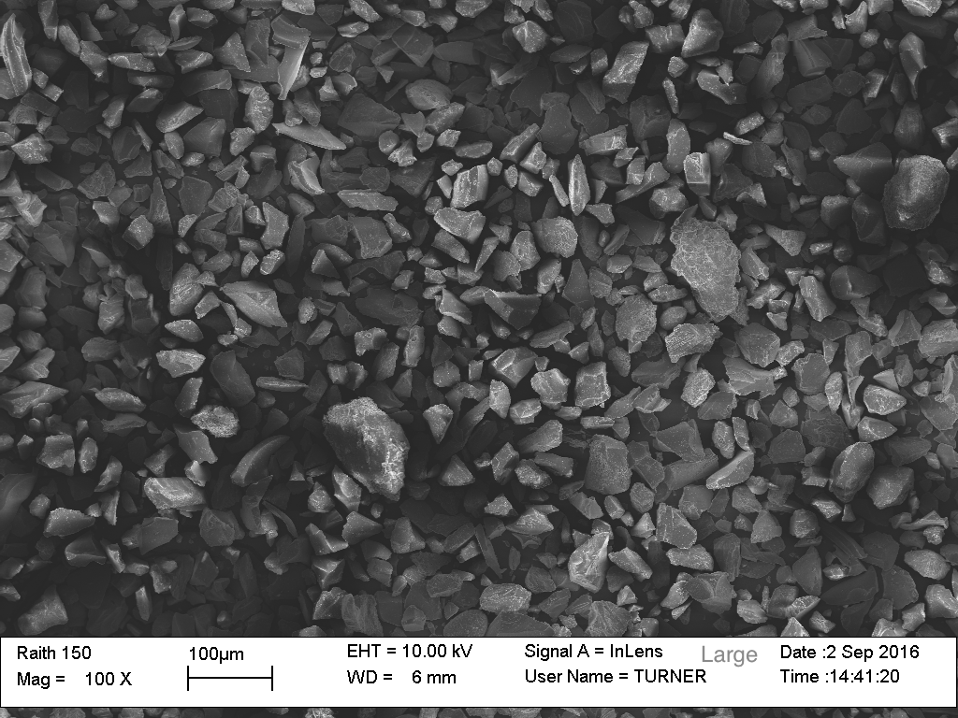
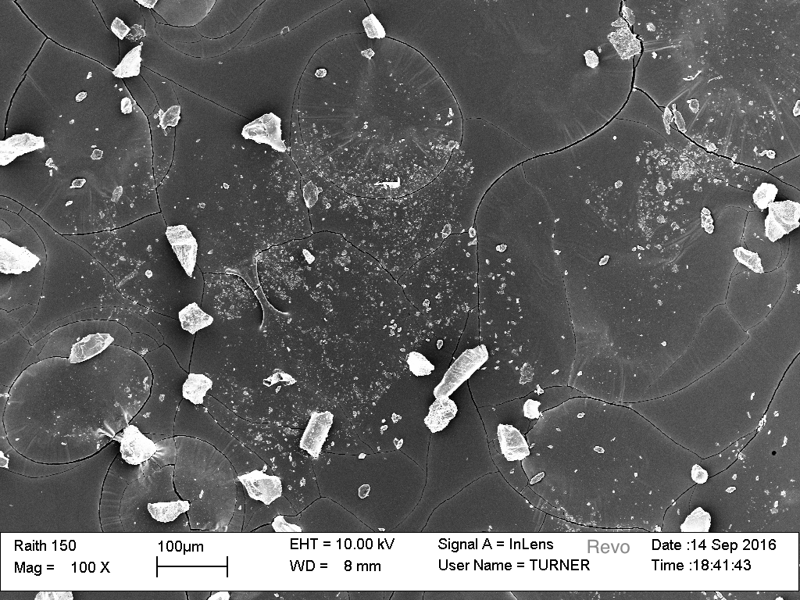
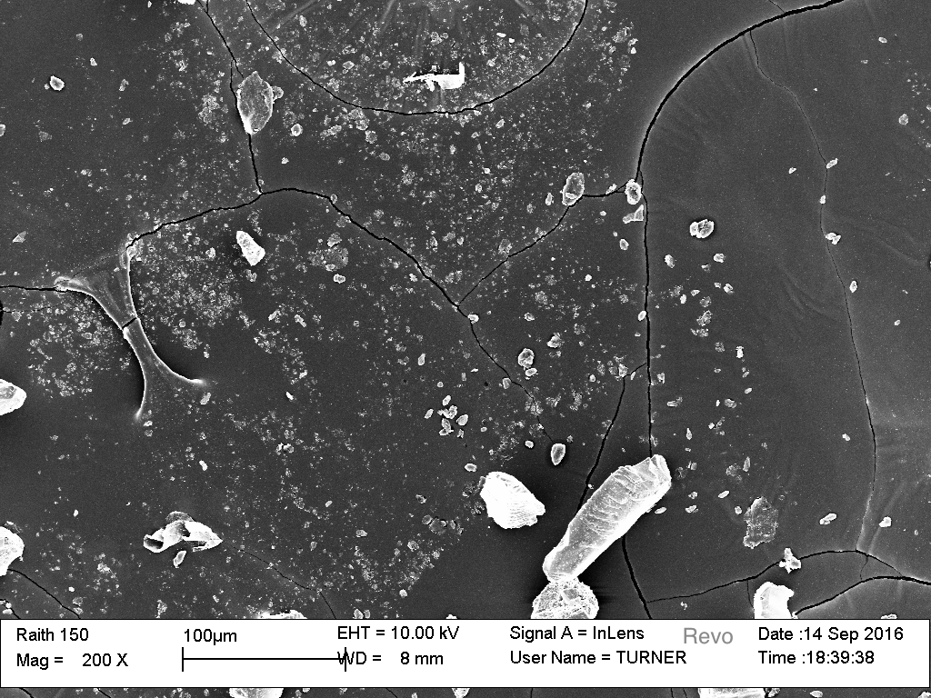
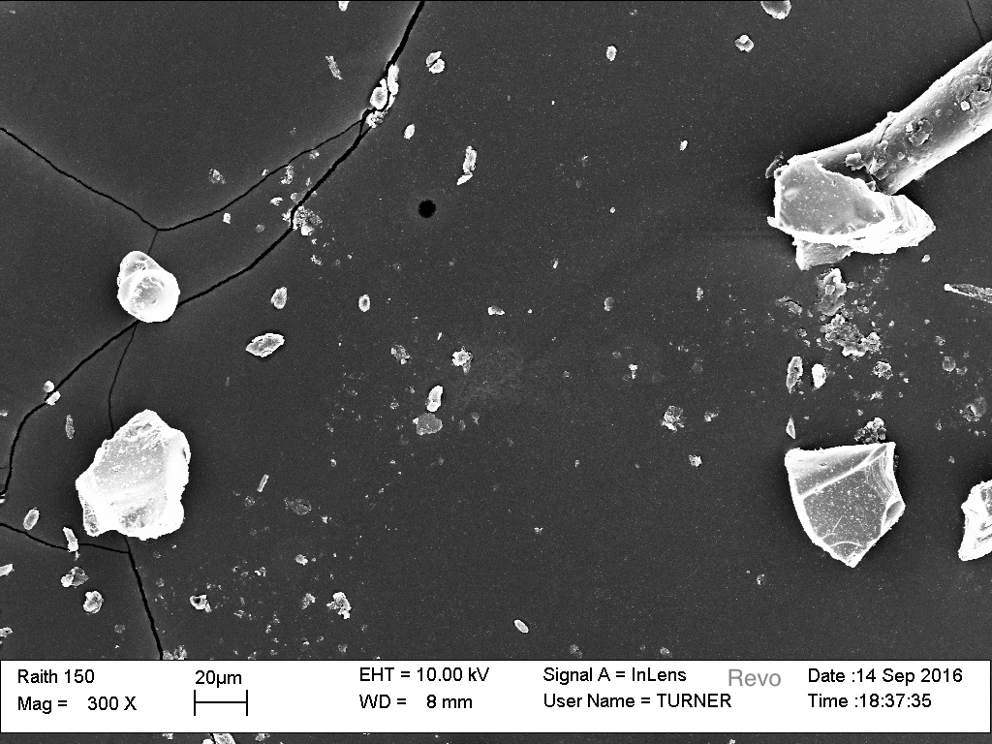
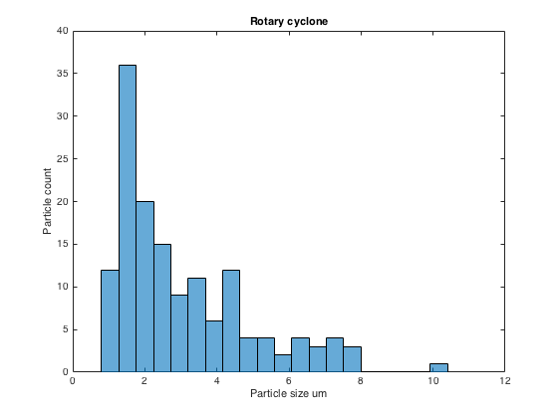
Results from SEM
100X
200X
100X
300X
Particle distribution

Slide 13
Future Development
Smooth surfaces inside cyclone for less surface friction
Air tight bottom compartment
Four chambers for smaller size
Add 360 degree rotation from servo (currently only 180 degrees)
The ability to set the cyclone at any angle relative to the base
Heating from telemetry to keep carbon tape warm

